Slide 1
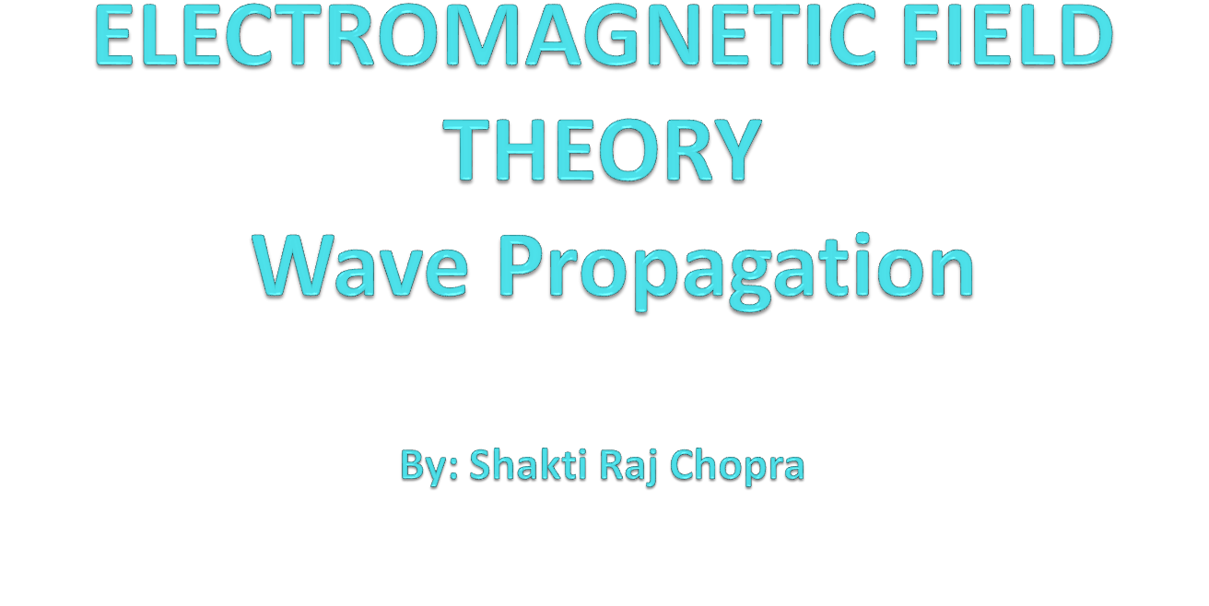

Slide 2
Books
Text Book:
1. PRINCIPLES OF ELECTROMAGNETICS
By - MATTHEW N.O. SADIKU, 4th 2009 OXFORD UNIVERSITY
PRESS, INDIA
Reference Book:
1. ELECTROMAGNETIC WAVES AND RADIATING SYSTEMS
By - EDWARD C. JORDAN 5th PRENTICE HALL

Slide 3
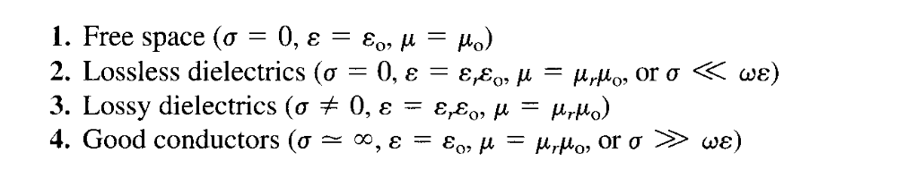
ELECTROMAGNETIC WAVE PROPAGATION
In general, waves are means of transporting energy or information.
In this chapter, our major goal is to solve Maxwell's equations and derive EM wave motion in the following media:

Slide 4

WAVE PROPAGATION IN LOSSY DIELECTRICS
A lossy dielectric is a medium in which an EM wave loses power as it propagates due to poor conduction.
In other words, a lossy dielectric is a partially conducting medium (imperfect dielectric or imperfect conductor) with as distinct from a lossless dielectric (perfect or good dielectric) in which
Consider a linear, isotropic, homogeneous, lossy dielectric medium that is charge free .

Slide 5
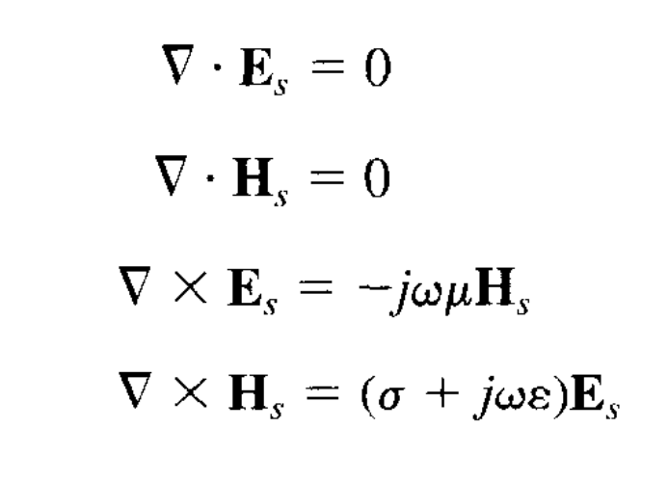
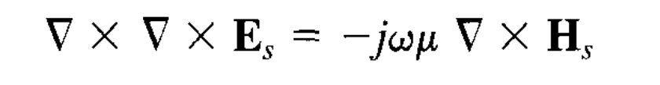
Taking the curl of both sides of eq. gives

Slide 6
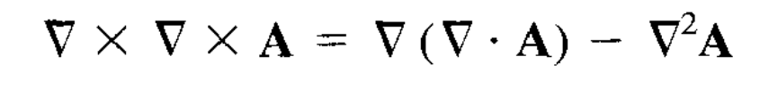
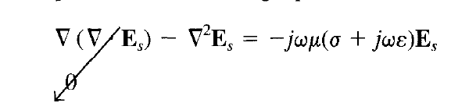
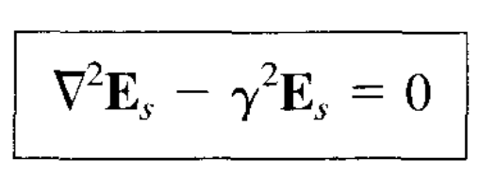
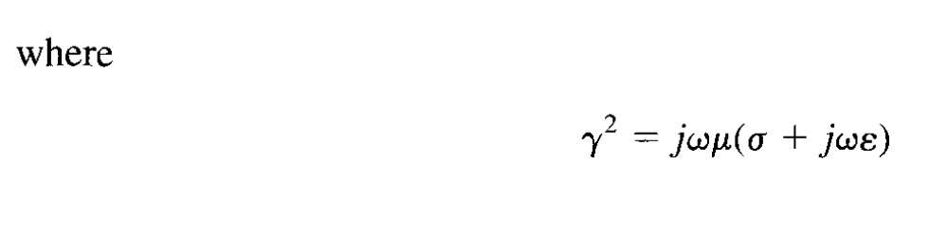
Applying the vector identity

Slide 7
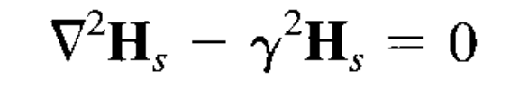
And is called the propagation constant (in per meter) of the medium.
By a similar procedure, it can be shown that for the H field.
Equations are known as homogeneous vector Helmholtz 's equations or simply vector wave equations.

Slide 8
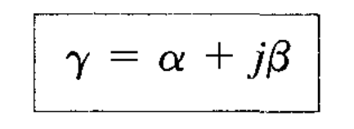
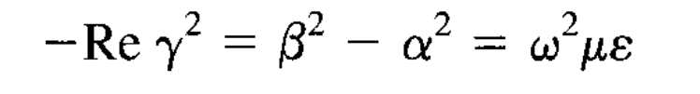
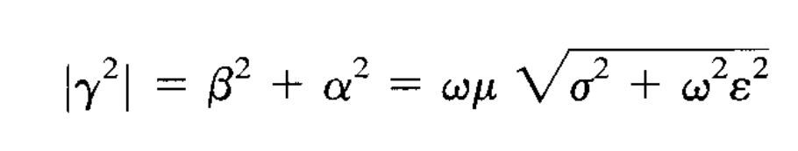
Since in eqs. is a complex quantity, we may let

Slide 9
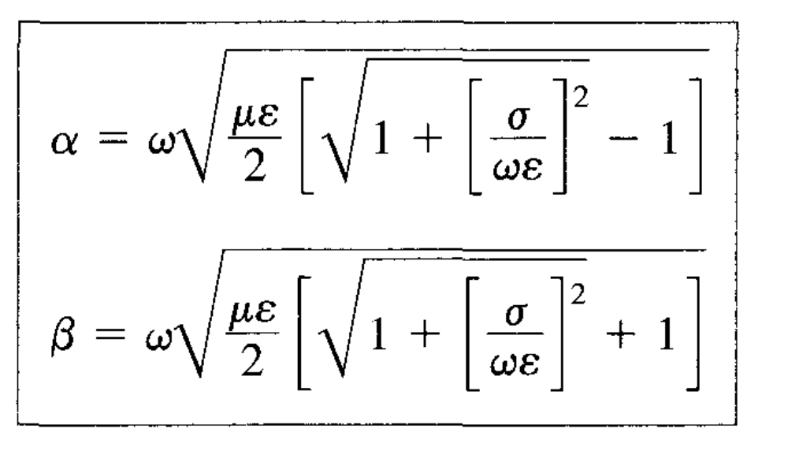

Slide 10
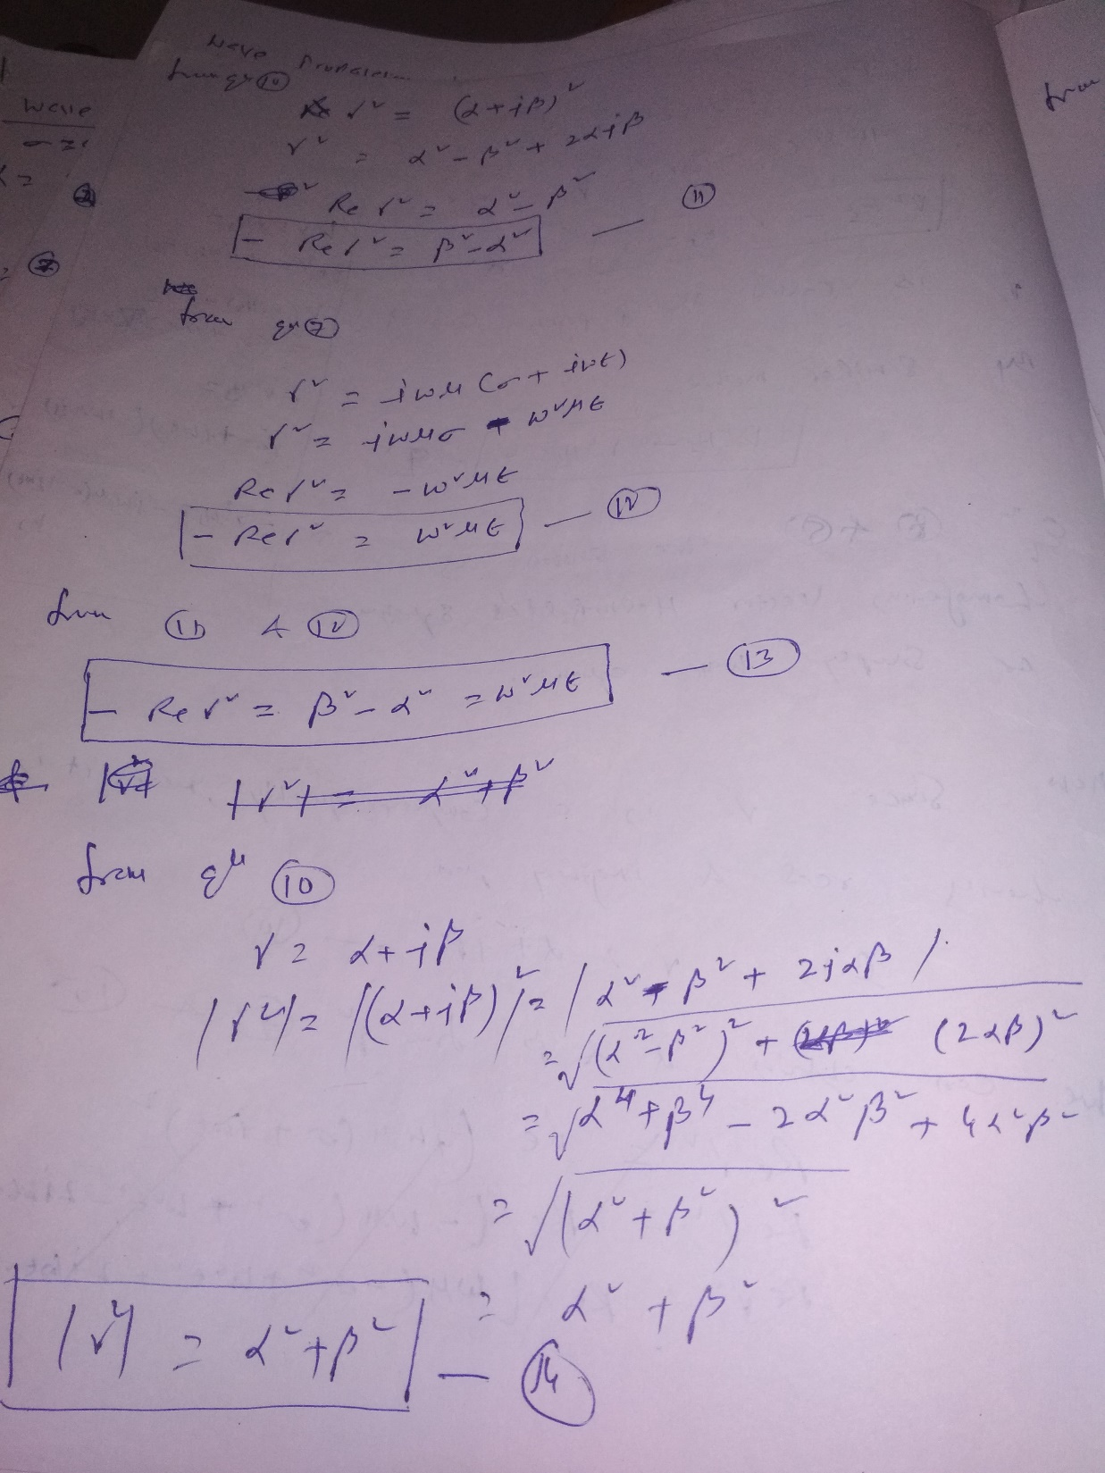


Slide 11
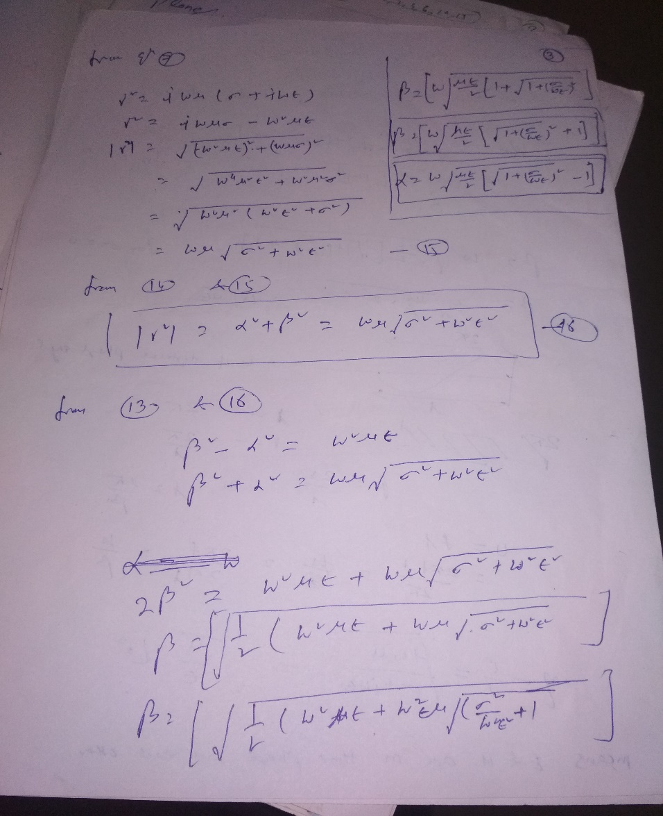

Slide 12


